Slide 1


Airfare Price Forecasting
Course: INFO8665-25W: Projects in Machine Learning
Presented by:
Prashansa Rathod - 8993410
Harsh Joshi - 8952840
Jaiv Burman - 8930180
Nidhi Ahir - 9041129
NilKumar Patel - 8983991

Slide 2

Introduction
Overview:
Airfare prices fluctuate due to factors such as demand, seasonality, airline policies, and external events.
Predicting airfare prices helps travelers book flights at optimal prices.
Project Goal:
Use machine learning to forecast airfare prices and provide insights into price trends.
Key Components:
Data Collection
Machine Learning Model Development
Deployment & Integration

Slide 3
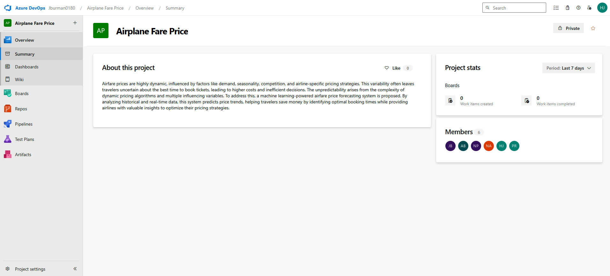
Azure DevOps Board Setup
Steps Taken:
Created Azure DevOps Organization & Project Workspace
Added Team Members & Assigned Access Rights
Ensured appropriate roles and permissions.

Slide 4
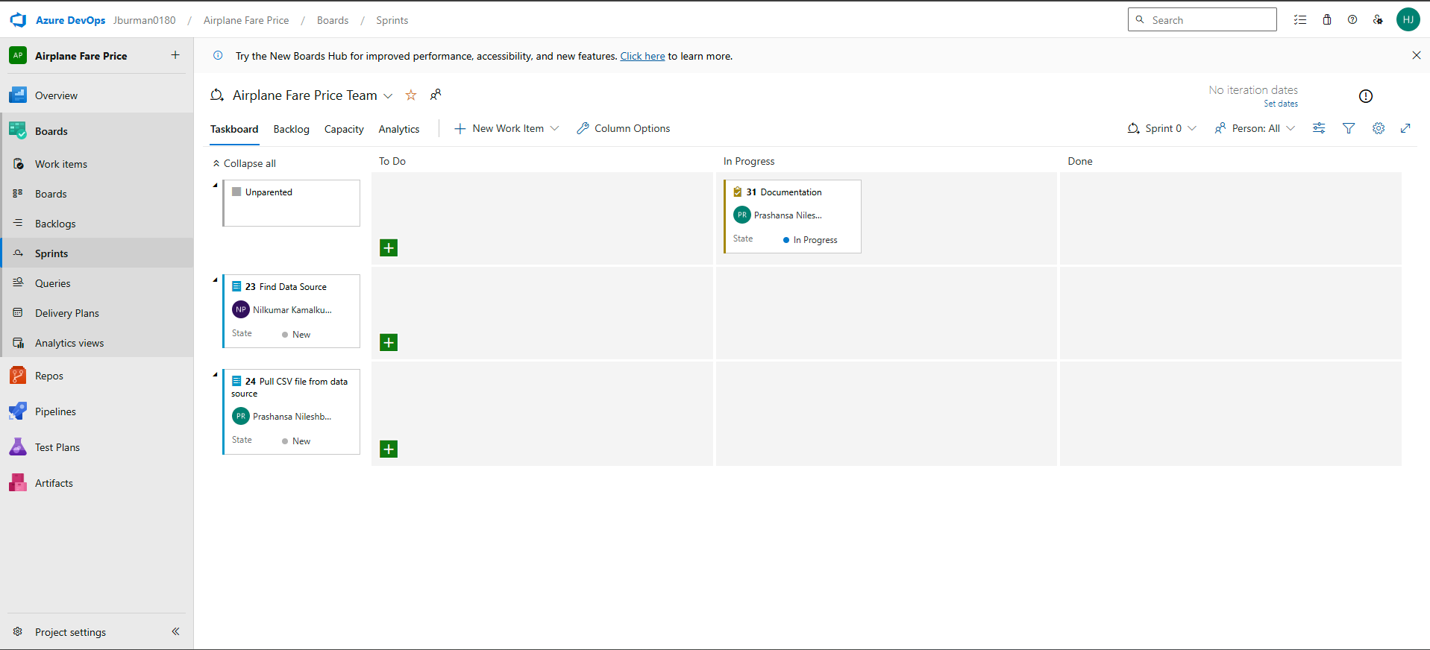
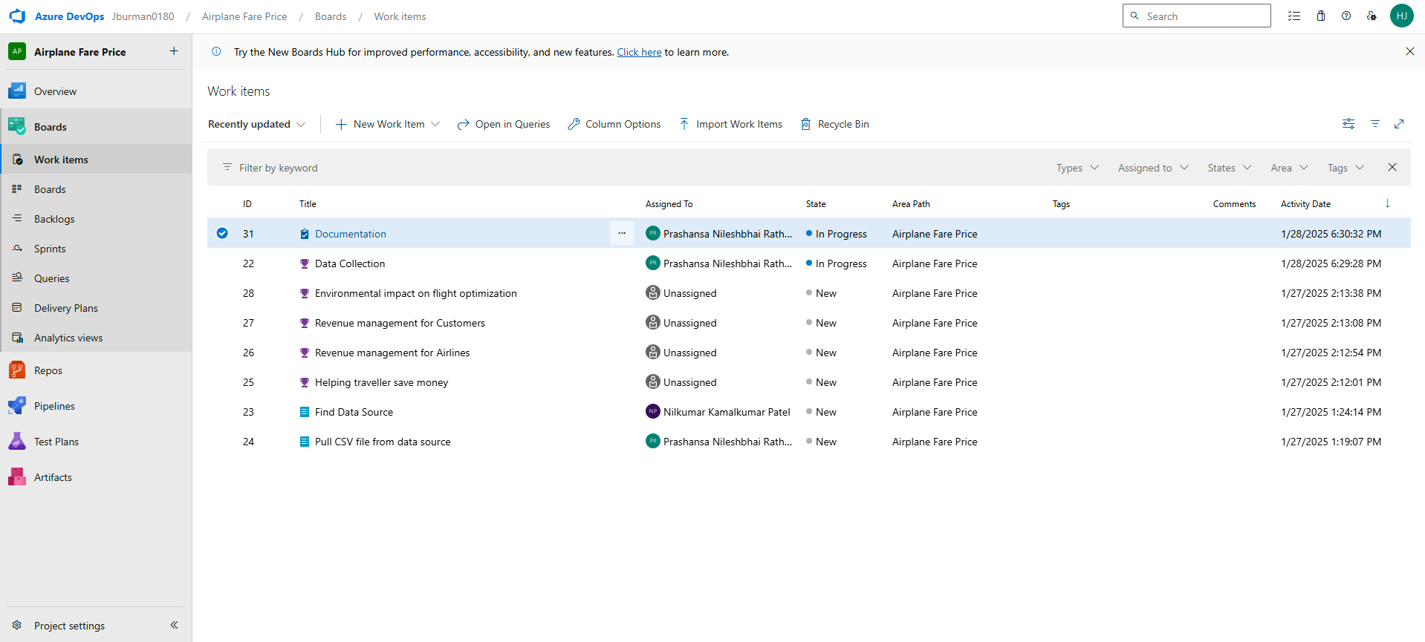
3. Set Up Boards, Sprints & Tasks Defined tasks with deadlines.

Slide 5
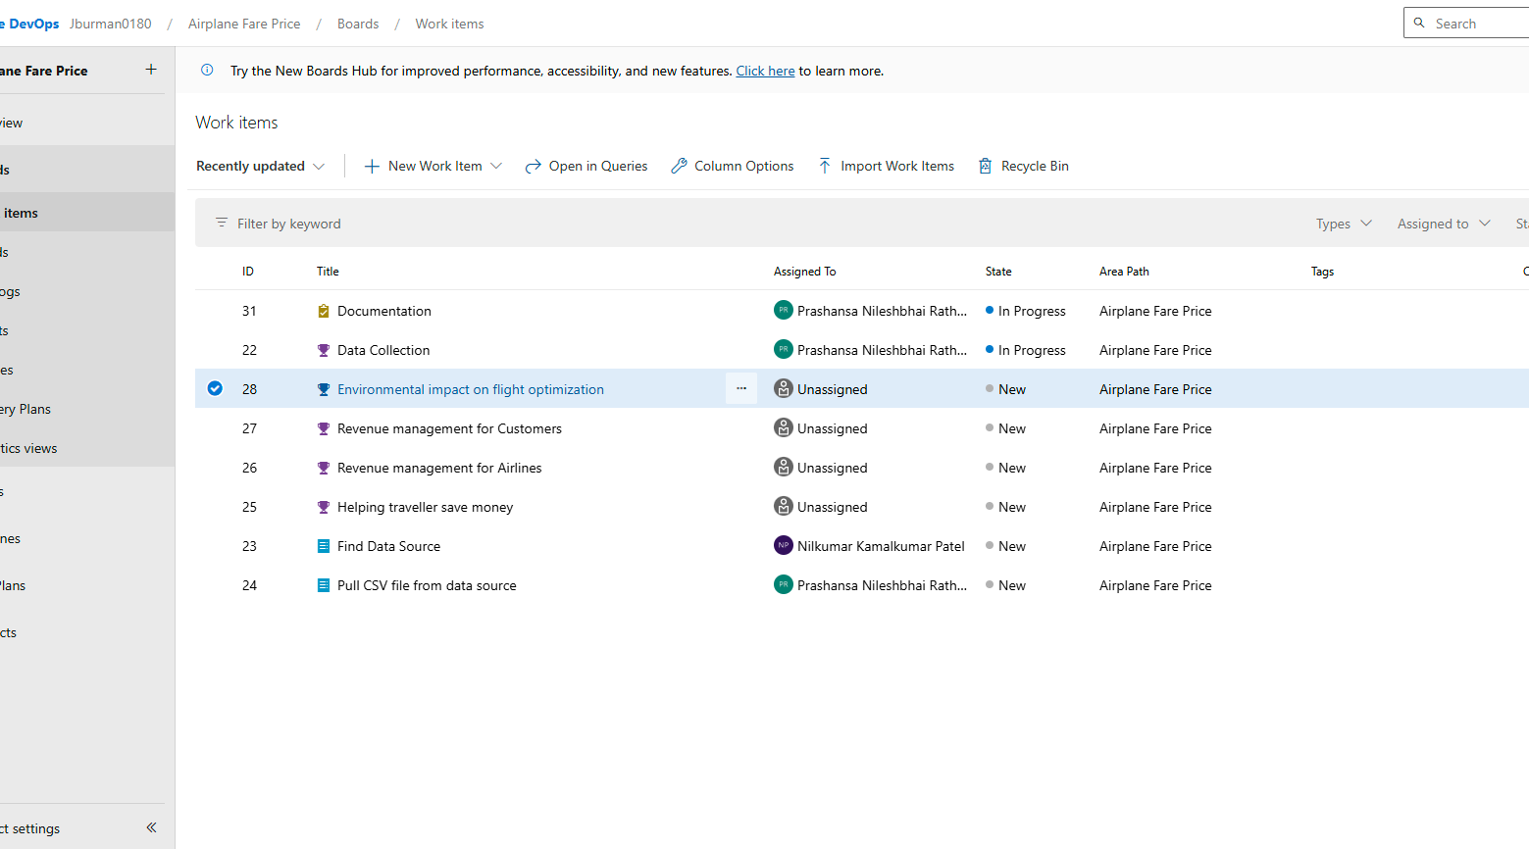
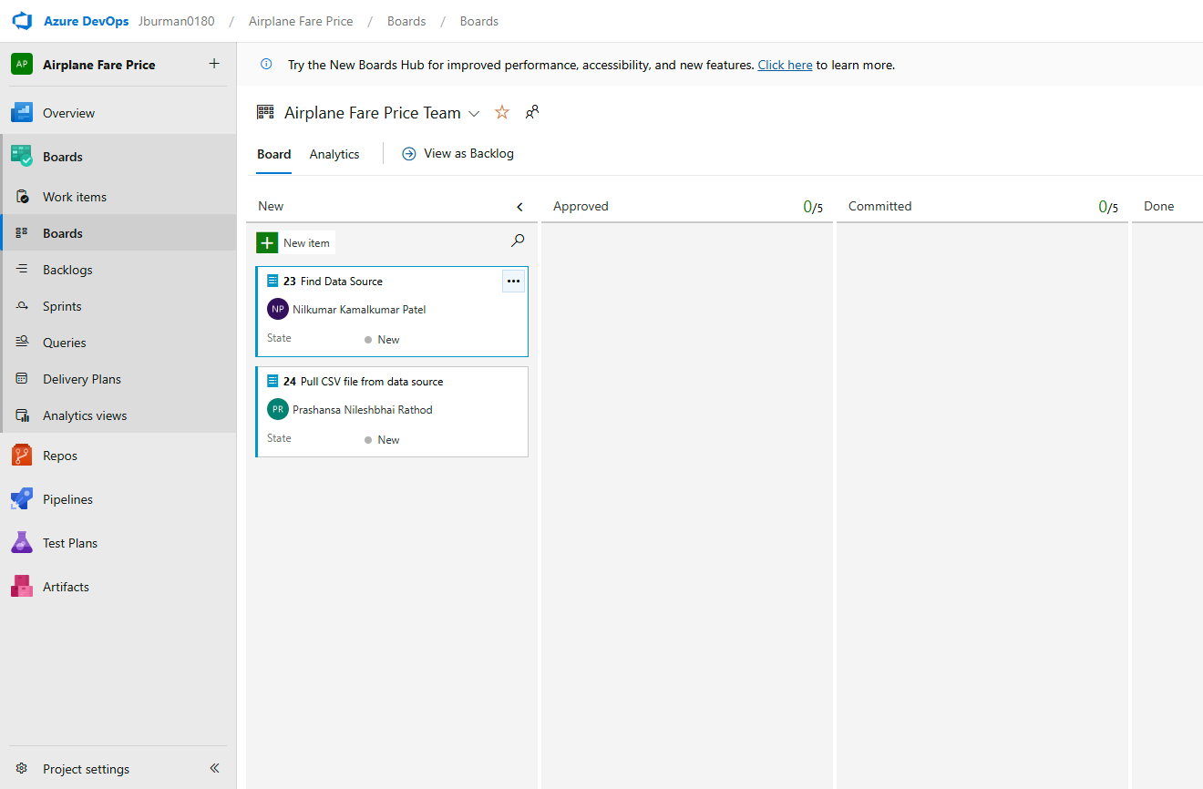

4. Created Features & User Stories
Aligned project goals with user needs.
5. Verified Task Assignments
Ensured all tasks were linked to responsible team members.

Slide 6
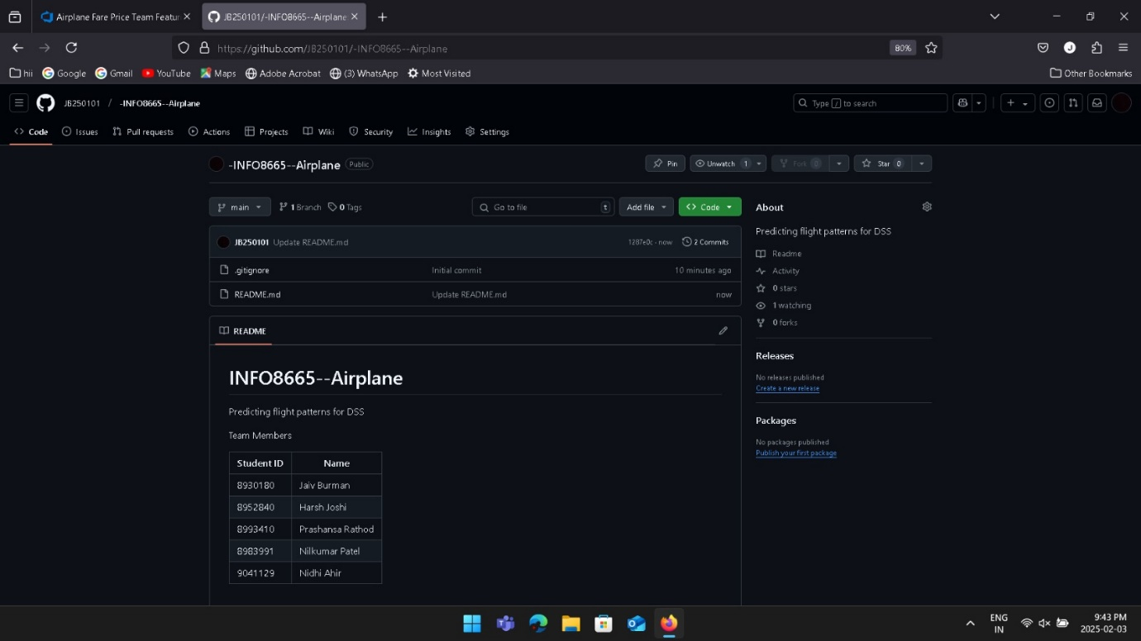
GitHub Repository Setup
Created a Private/Public GitHub Repository

Slide 7
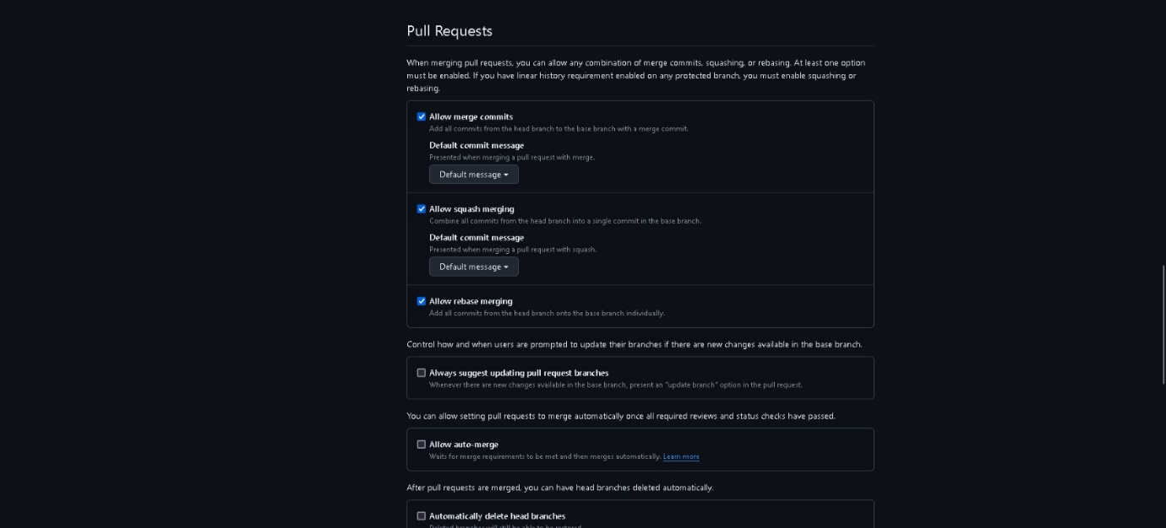
2. Added Collaborators (Team Members & Instructor)
Implemented a Branching Strategy
3. Main Branch: Stable version of the project.
Feature Branches: Development of new features.

Slide 8
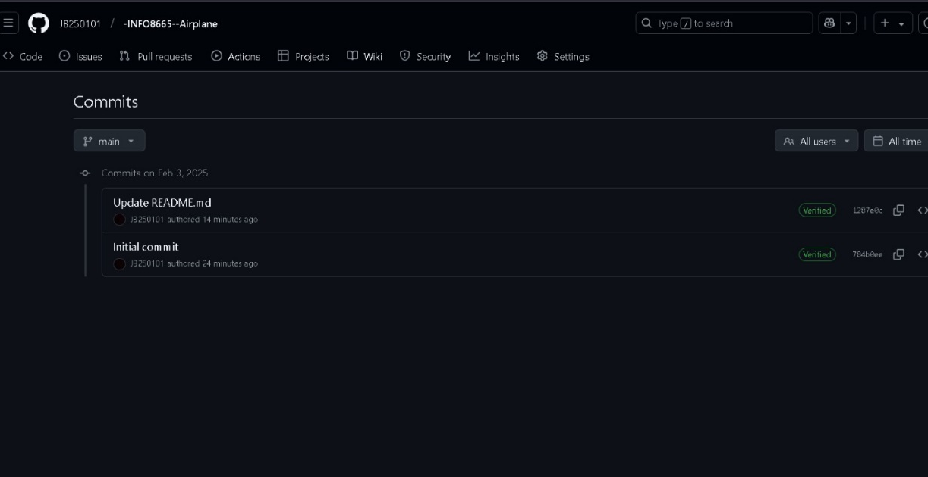
4. Made Initial Commit & Verified Access:
Tested repository setup to ensure smooth collaboration.

